Slide 1
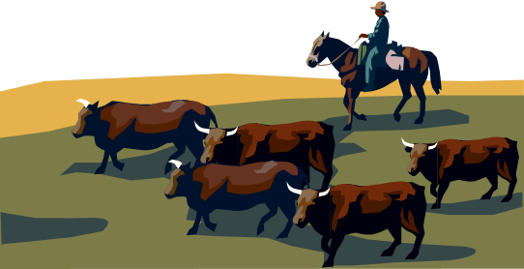
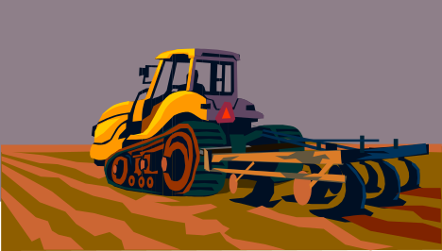
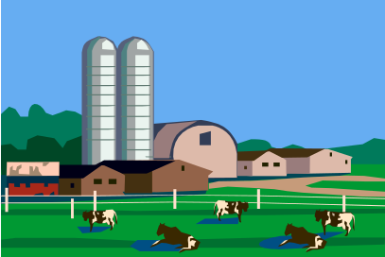
Introduction to Starting an Ag/Hort Business
AREC 213
Notes:
In 2006, nearly 650,000 businesses were started in the US.
More than 550,000 closed.
This class is intended to improve your chances for success in launching a new business enterprise.

Slide 2
Household Budget
What is a Budget?
  Quantify Your Income and Expenses
How do I Make a Budget?
  Make a List (Spreadsheet)
What Do I Do With My Budget?
  Revise as Needed
Make Your Household Budget
Syllabus

Slide 3

Business Plan
10 Steps
Executive Summary
Value Proposition
Company Description
Market Description & Opportunity Assessment
Product/Service Description
Competitive Assessment
Marketing & Sales Strategy
Operations
Management and Employees
Financial Summary
Introduction
Notes:
This particular organization is based on developmental order.

Slide 4
A Value Proposition is:
Your business idea in a nutshell
A clear statement of the tangible value/results your customers get from using your products/services
Answers why your business will succeed
Specific and compelling
Introduction
Notes:
30 second elevator speech to a stranger.
Grandmother should be able to understand the value proposition.

Slide 5
Mission Statement
A Short and Simple Statement
  Outlines an Organizations Purpose
Composed of Three Components:
  Key Market
    Target Client or Customer
  Contribution
    What Product/Service is Provided
  Distinction
    Uniqueness of Product/Service
Introduction
Notes:
30 second elevator speech to a stranger.
Grandmother should be able to understand the value proposition.

Slide 6

Value Proposition Example
Weak – “We offer a wide variety of apple trees.”
Stronger – “We offer high vigor hybrid apple trees that yield 5% more than standard varieties.”
Introduction
Notes:
30 second elevator speech to a stranger.
Grandmother should be able to understand the value proposition.

Slide 7

Guess Who’s Value Proposition This is
“We provide a friendly, comfortable, well-located place offering a wide range of fresh, customized quality coffees, teas, and other beverages for the person who enjoys a good experience and a good beverage.”
Introduction
Notes:
30 second elevator speech to a stranger.
Grandmother should be able to understand the value proposition.

Slide 8
Your Value Proposition Contains:
What (your product or service)
To Whom (your customer)
Why (your competitive advantage)
Introduction
Notes:
30 second elevator speech to a stranger.
Grandmother should be able to understand the value proposition.

Slide 9




Value Proposition
Dimensions of Value
Innovative Offering
A better mousetrap
Features
Performance
Packaging
Introduction

Slide 10



Value Proposition
Dimensions of Value
Lower Cost
The same, for less
Introduction

Slide 11



Value Proposition
Dimensions of Value
Quality, Reliability
Best quality
Introduction

Slide 12



Value Proposition
Dimensions of Value
Customer Responsiveness
Customer is #1
Introduction

Slide 13

Value Proposition
Dimensions of Value
Unique Niche
  Location
  Customer Knowledge
  Specialized Know-How
Local is Better
Introduction

Slide 14

Value Proposition
Now Write Yours…
What (your product or service)
To Whom (your customer)
Why (your competitive advantage)
Introduction
Notes:
30 second elevator speech to a stranger.
Grandmother should be able to understand the value proposition.

